Slide 1
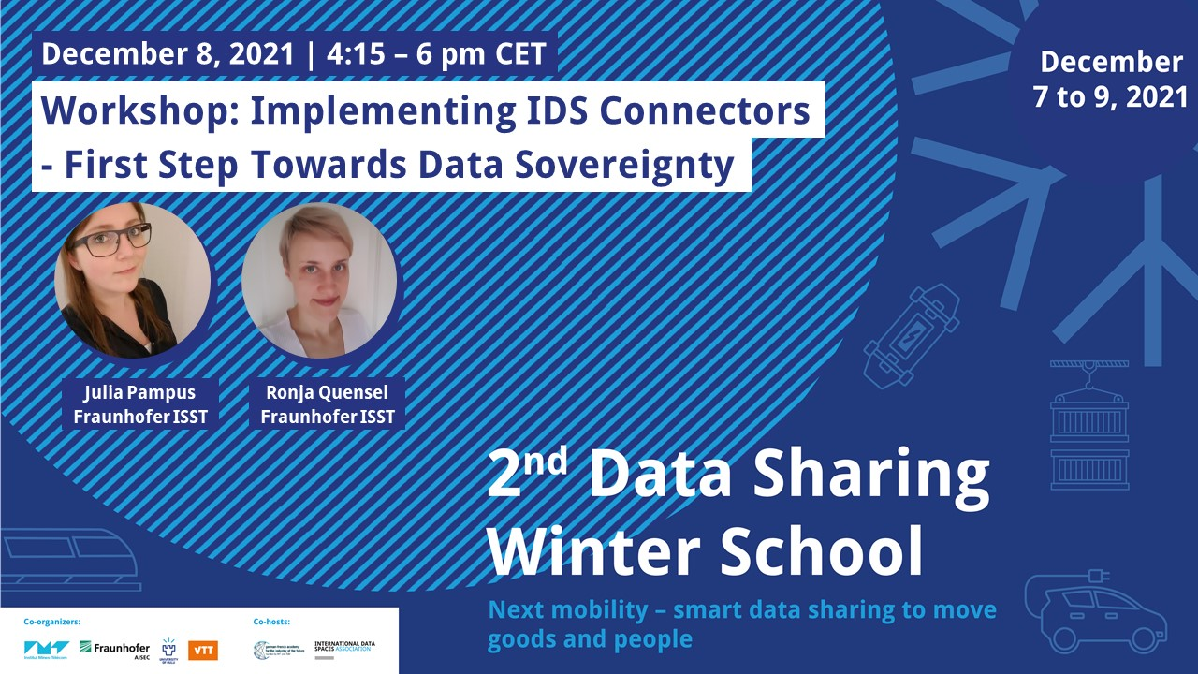

Slide 2
Agenda
What is this Workshop all about?
16:15 Project Overview + Q&A
16:45 Introduction to Samples (Sample 1)
17:00 Working Phase (Samples 2 + 3)
17:30 Guided Walkthrough (Sample 4)
17:45 Questions
18:00 End

Slide 3
Eclipse Dataspace Connector
Project Overview ‧ Julia Pampus

Slide 4
Background
Dataspace Connector
IDS Connector reference implementation developed by Fraunhofer ISST
Open-source project supported by IDSA
Used in various projects (research and industry) and use cases
Mobility Data Space: data sharing community to build future of mobility
Catena-X Automotive Network: alliance for secure and standardized data exchange along the automotive value chain

Slide 5
Motivation
New Challenges
Different architectures and implementations for data space services
Organizations participate in various data spaces
Connection and interoperability with multiple data spaces
Identity across multiple jurisdictions
Catena-X, MDS, and other initiatives present new data sharing challenges
Support for data flow and transfer protocols to handle diverse data types
Push, Streaming, Large Volumes, Realtime
Cataloging across many providers
Policy management that traverses multiple infrastructure layers
Need for extensibility and modularity to accommodate diverse needs and use cases

Slide 6
Open Source Project
Goals
Framework to address key data sharing use cases
Architecture and project for many interested parties to collaborate on
Provide platform to implement new ideas and use cases
Help evolve IDS and GAIA-X
Data exchange endpoint in a federated data system, or Dataspace
Focus on data transfer (sharing) and policy management (sovereignty)
Open source project
Eclipse Foundation
Joining knowledge, people, and code bases
Based on Dataspace Connector (Fraunhofer) and Data Appliance GX (Microsoft)

Slide 7




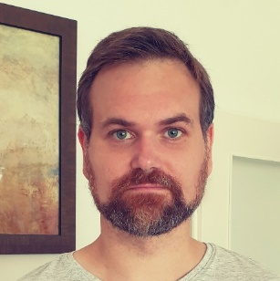




Contributors
Initial Committers
Markus Spiekermann
Fraunhofer ISST
Alexandru Danciu
SAP SE
Stefan Ettl
BMW AG
Moritz Keppler
Daimler TSS GmbH
Florian Seidel
Amazon AWS
Julia Pampus
Fraunhofer ISST
Werner Jost
Deutsche Telekom AG
Franco Wolf
ZF Friedrichshafen AG
Jim Marino
Microsoft

Slide 8
Features
Key Design Principles and Features
Based on a simple modularity system
Separate control and data planes
System is asynchronous and highly available
Transfer processes are fully auditable
Eliminate single points of failure
Cloud aware policy enforcement and projection
System security

Slide 9
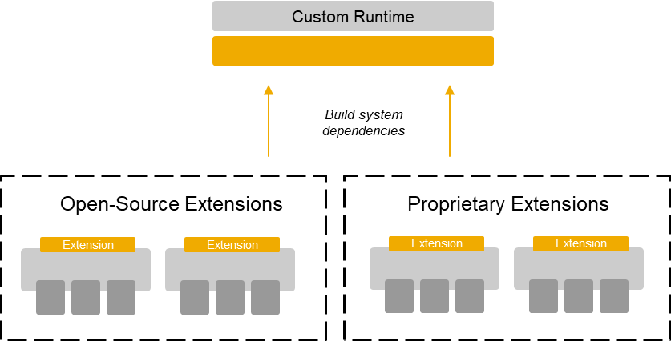
The EDC …
… is modular and extensible
Java-based Gradle multi-module project
Modules are assembled into a runtime
Data cataloging handled by external system
e.g., Apache Atlas
Modularity allows this to be substituted
Data transfer and storage performed out of band
Modularity allows this to be substituted or augmented
Ability to add multiple transfer mechanisms to support diverse data types
Solves key aspects of how to handle streaming, large data transfer, and hyper scaling

Slide 10
The EDC …
… is a coordinator
Processes are modeled as persistent state machines
Nearly symmetric on the consumer and provider connector
Includes states for initiation, receipt, resource provisioning, transfer, and termination
State transitions happen asynchronously after a defined task is completed
Tasks must be idempotent for reliability
Processes are persisted to a store
Highly available database with geographic fail over, or a simple in-memory map
Provides a foundation for full observability and data audit
Metadata about each state is recorded
Observability by correlating the process id with separate telemetry data

Slide 11
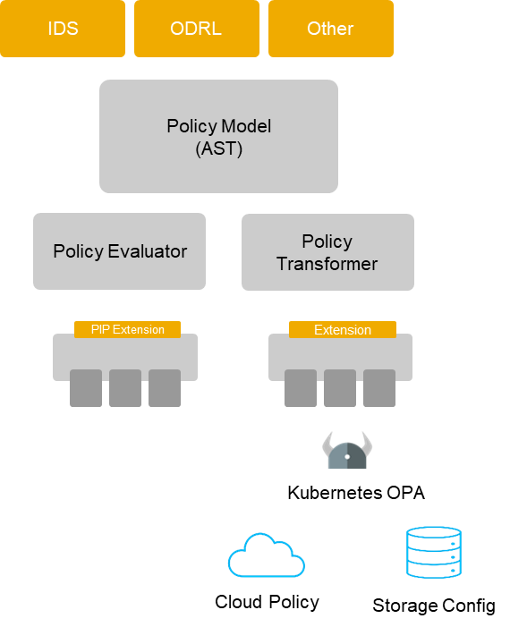
The EDC …
… provides cloud-aware policy enforcement
Policy engine that is cloud aware
Not limited to the connector
Can be embedded in other processes
Horizontal and vertical enforcement
Parses policy syntax into an internal Policy Model AST
Evaluators and transformers to enforce policy
Evaluators can make policy decisions, e.g. is a connector authorized
Transformers can create and deploy policy to different levels (OPA, storage, etc.)

Slide 12
Status-Quo and Roadmap
Latest Changes
Official Eclipse project since June 2021
Initial contribution has been made, checked and approved by Eclipse Foundation
Current results
Provide assets (IDS compliant self-description and contract offers)
OAuth2 and SSI authentication
Data flow, transfer and resource provision
Policy negotiation (IDS messaging protocol) and contract-aware data transfer
Provide samples for different use cases
Release of EDC v0.0.1-SNAPSHOT (maven artifacts)
Q1/2022: 3rd EDC Hackathon

Slide 13
Key Takeaways
The EDC …
… is completely FOSS supported by various companies.
… has clear and accepted governance structure & community processes.
… is more than connecting a database.
… manages data transfer and flow including management of contracts and policies in cloud-native environments.
… follows a modular system to serve as facilitator.
We have a good foundation already present on GitHub. There is still work to do. We welcome everyone to drive the idea and grow the community!

Slide 14




Contact Information
Important Links

Slide 15
Eclipse Dataspace Connector
Hands-on ‧ Ronja Quensel

Slide 16
Agenda
What is this Workshop all about?
16:15 Project Overview + Q&A
16:45 Introduction to Samples (Sample 1)
17:00 Working Phase (Samples 2 + 3)
17:30 Guided Walkthrough (Sample 4)
17:45 Questions
18:00 End

Slide 17
Any Questions?
Share Your Comments & Thoughts

Slide 18


Contact
Thank You For Your Attention!
Julia Pampus
Ronja Quensel
Fraunhofer ISST
Data Business, Research Assistant​
julia.pampus@isst.fraunhofer.de
+49 (0) 231 / 9 76 77 - 429​
Fraunhofer ISST
Data Business, Technical Employee
ronja.quensel@isst.fraunhofer.de
+49 (0) 231 / 9 76 77 - 404

